Slide 1
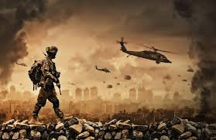
“Poets go to War”
Queenscliff Library
Friday 23rd August from 10am to 12noon
“every beautiful poem is an act of resistance”.

Slide 2
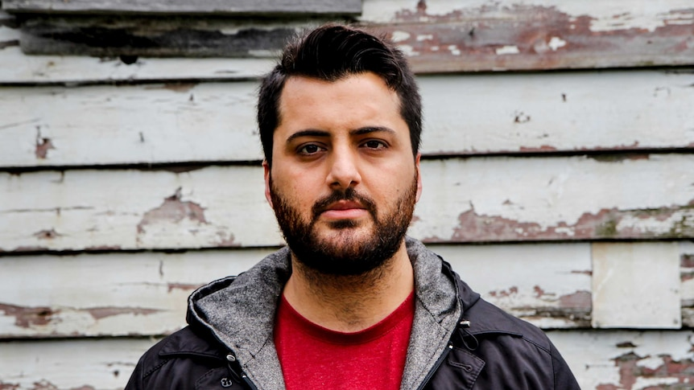
Context in a broken duplex by Omar Sukar
Context in a Broken Duplex | New Australian poetry, contemporary Australian writers & poetry education | Red Room Poetry

Slide 3
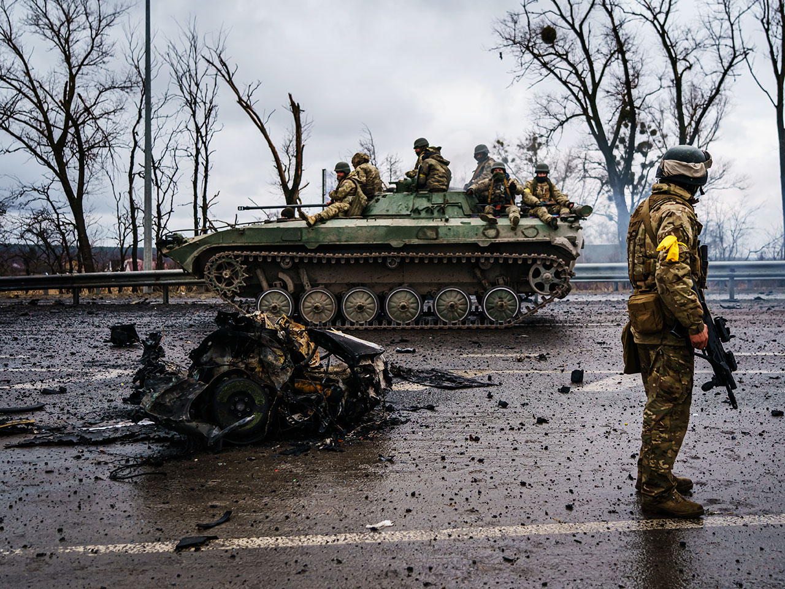
Questions to ponder…
1. How would you define a ‘war poet’ or ‘war poetry’ ?
2. Are war poets necessarily anti-war?
3. Can poetry make any difference to world events?
(the power of words, incantations & chants)
4. Are there common traits particular to ‘war poetry’?

Slide 4
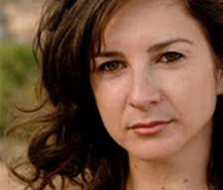
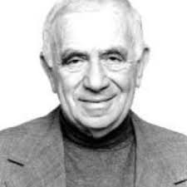
ISRAELI POETS
Elana Bell – your village
Elana Bell performs "Your Village" – YouTube
Yehada Amitchai – (1) the diameter of the bomb
The Diameter of The Bomb by Yehuda Amichai #shorts #israel #news #war #palestine (youtube.com)
            (2)-try to remember some details

Slide 5
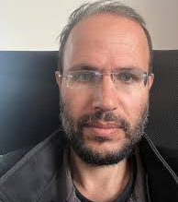
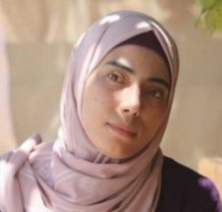

OETS
PALESTINIAN POETS
Refaat Alareen – If I must die
If I must die.. (youtube.com)
Hibu Aba Nada – I grant you refuge
I Grant You Refuge - Hiba Abu Nada (youtube.com)
Mosab Abu Toha – leaving childhood behind
What is home What a Gazan should do during an Israeli airstrike
What a Gazan Should Do During an Israeli Air Strike: a poem by Mosab Abu Toha (youtube.com
The Power Of Words: Incantations And Chants (theenlightenmentjourney.com))
Refaat Alareen – If I must die
If I must die.. (youtube.com)
Hibu Aba Nada – I grant you refuge
I Grant You Refuge - Hiba Abu Nada (youtube.com)
Mosab Abu Toha – leaving childhood behind
What is home
What a Gazan should do during an Israeli airstrike
What a Gazan Should Do During an Israeli Air Strike: a poem by Mosab Abu Toha (youtube.com)
Omar Sakr - - Context in a Broken Duplex
Context in a Broken Duplex | New Australian poetry, contemporary Australian writers & poetry education | Red Room Poetry

Slide 6
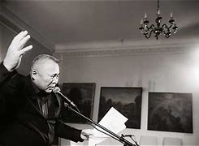

RUSSIAN POETS
Amarsana Ulztuew –
Businessman from Mongolia
Eddies Funeral
-Artem Kamardin
Kill me Militiaman (ARTEM KAMARDIN (youtube.com)

Slide 7
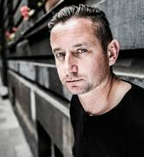
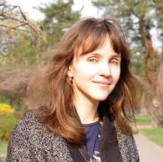
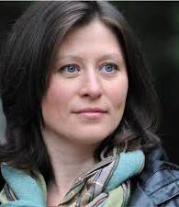
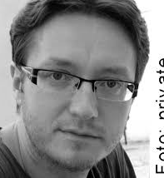
Ukrainian Poets
Serhig Zhada
So I’ll talk about it As If This Winter Never Happened
135 Two poems - Serhiy Zhadan (youtube.com)
Iya Kiva -memory dries like grass in summer’s garden
April 24 🇺🇦 - Untitled “memory dries like grass…” by Iya Kiva | read by Kirk Lawrence-Howard (youtube.com)
Halyna Kruk –Untitled
Bifurcation point
Untitled
Ostap Slyvynsky - Amber
“
Back to Omar Sakr

Slide 8
Writing a Duplex – Jericho Brown……,Duplex (I begin with love)
I begin with love, hoping to end there. (line one)
I don’t want to leave a messy corpse. (change impression of 1st in an unexpected way
I don’t want to leave a messy corpse (echo the second line)
Full of medicines that turn in the sun. (change impression of 3rd line in an unexpected way)
Some of my medicines turn in the sun. (echoes 4th line)
Some of us don’t need hell to be good. (changes impression of 5th line in an unexpected way)
Those who need least, need hell to be good. (echoes 6th line)
What are the symptoms of your sickness? (changes impression of 7th line unexpectedly)
Here is one symptom of my sickness: (echoes 8th line)
Men who love me are men who miss me. (changes impression of 9th line unexpectedly
Men who leave me are men who miss me (echoes 10th line)
In the dream where I am an island. (changes impression of 11th line)
    In the dream where I am an island, (repeats line 12)
I grow green with hope. I’d like to end there. ( repeat line one )
( I begin with love – Jericho Brown) - Bing Videos

Slide 9
Common traits particular to ‘war poetry’?
1. Repetition, chants, litanies, mantras, incantations with intention -religious association
2. Indirect descriptions, use of metaphors – direct description too horrible to write
3. A lot of questioning
4. Humour, use of the absurd
5. Using phrases found in media (common use)

